Slide 1
Design and Implementation of a Project Management API using Python and Blockchain Technology
Nolan Byrnes

Slide 2
Bottom Line Up Front
Smart Contracts can be used to help manage a project.
When all conditions of Smart Contract are met, the Project NFT will be funded
Storing Projects as NFT’s (Non-Fungible Tokens) allows us to store our projects securely
Developing an API can make it easy for companies to utilize this solution for completing projects, and ultimately paid upon completion of a project.
Notes:
In order to Close a Project, there are requirements that must be fulfilled, such as the Product, Documentation, User Guides, Etc. We can have all of these items built into a smart contract, to where the project will not be funded until all of the requirements are met.
Storing Projects and associated documents as an NFT is secure, and only the ones who have purchased the Project NFT has access to the Project documents.
Creating an API, we can make it easy for companies to Create Smart Contracts, Fulfill those contracts, and be funded upon completion of the Smart Contract.

Slide 3
Benefits of Blockchain
Enhanced Security
Blockchain records can not be altered.
Blockchain records are encrypted end to end.
Instant Traceability and Transparency
Blockchain creates an Audit trail, making it easy to track the progress of a Project.
Automation
Transactions can be automated with “Smart Contracts”. We can have a project automatically funded when all of the requirements of the project are met.
Notes:
Since records on the Blockchain are encrypted from end to end, we can ensure that only the relevant parties have access to view the information.
Blockchain makes an Audit trail, making it easy for a Project Manager to see how fast a project is getting completed., since Documents and information sent to a Project NFT will be timestamped.
A Project NFT will automatically be funded by the purchaser when all the set requirements are met.

Slide 4
Benefits of using Python API
Using an API, we can send the required data that we need through the Block Chain.
Future Projects can use the Developed API to create a custom front end of a website for end users to easily track their projects using our Project Management Product using Blockchain.
Notes:
Different types of Projects have different requirements. Having an API to connect to the blockchain will allow customization in the front end, where projects can crate their own front end website to where individuals can easily create Smart Contracts, view the status of the contract, and submit their required documents. Creating a custom form in the front end allows project managers to include the requirements that are relevant for a particular type of project.

Slide 5
Using Python API and Blockchain together
Using an API to create and read records in the Project Management Blockchain makes it easy for end users to send the required information to the Blockchain.
Creating the API allows for customers to create their own custom front end that is best for their project management style. (Agile, Waterfall, etc.)
Using Blockchain to store the information and progress of a project is a secure way to track the progress of a project.
Notes:
By using an API to communicate with the Blockchain, we create a gateway for Project Managers to define the requirements of a particular project they are creating, as well as to retrieve the status of the project. It also allows the Systems Engineers to submit the Source Code and Documentation to a particular Project that he is working on.
When this final product is released, teams that are using this API can develop their own custom Front End websites that fit to their needs and wants. They will be able to create specific forms to help them create Smart Contracts, Project requirement submissions forms, and customize the way they view their data. They can also customize the color scheme of the website to help the site look how they want it to.
Using the Blockchain stores all of the documents of the project securely, being encrypted end-to-end, and using the API allows the teams that work on a particular project to easily utilize the Blockchain technology to track, complete, and manage their projects.

Slide 6
Smart Contracts
Smart Contracts Execute when all predetermined conditions are met
Funds can be transferred from the purchaser, to the companies Ethereum wallet when all predetermined conditions are met, such as Source Code, Documentation, Etc.
Notes:
Creating a Smart Contract can be used to set the required documents that need to be provided in order to Close a Project. This can include Source Code to a project, Documentation, user guides, etc.
When all the requirements are met of the Smart Contract that is configured, the Smart Contract can transfer the funds for the project from the purchaser to the companies Ethereum Wallet.
Using the Smart Wallet, the Purchaser of the project is ensured that they are getting what they paid for, and it also ensures that all the requirements are being met before the project is completed.
References:
What are smart contracts on Blockchain? IBM. (n.d.). Retrieved April 2, 2022, from https://www.ibm.com/topics/smart-contracts#:~:text=Next%20Steps-,Smart%20contracts%20defined,intermediary's%20involvement%20or%20time%20loss.

Slide 7
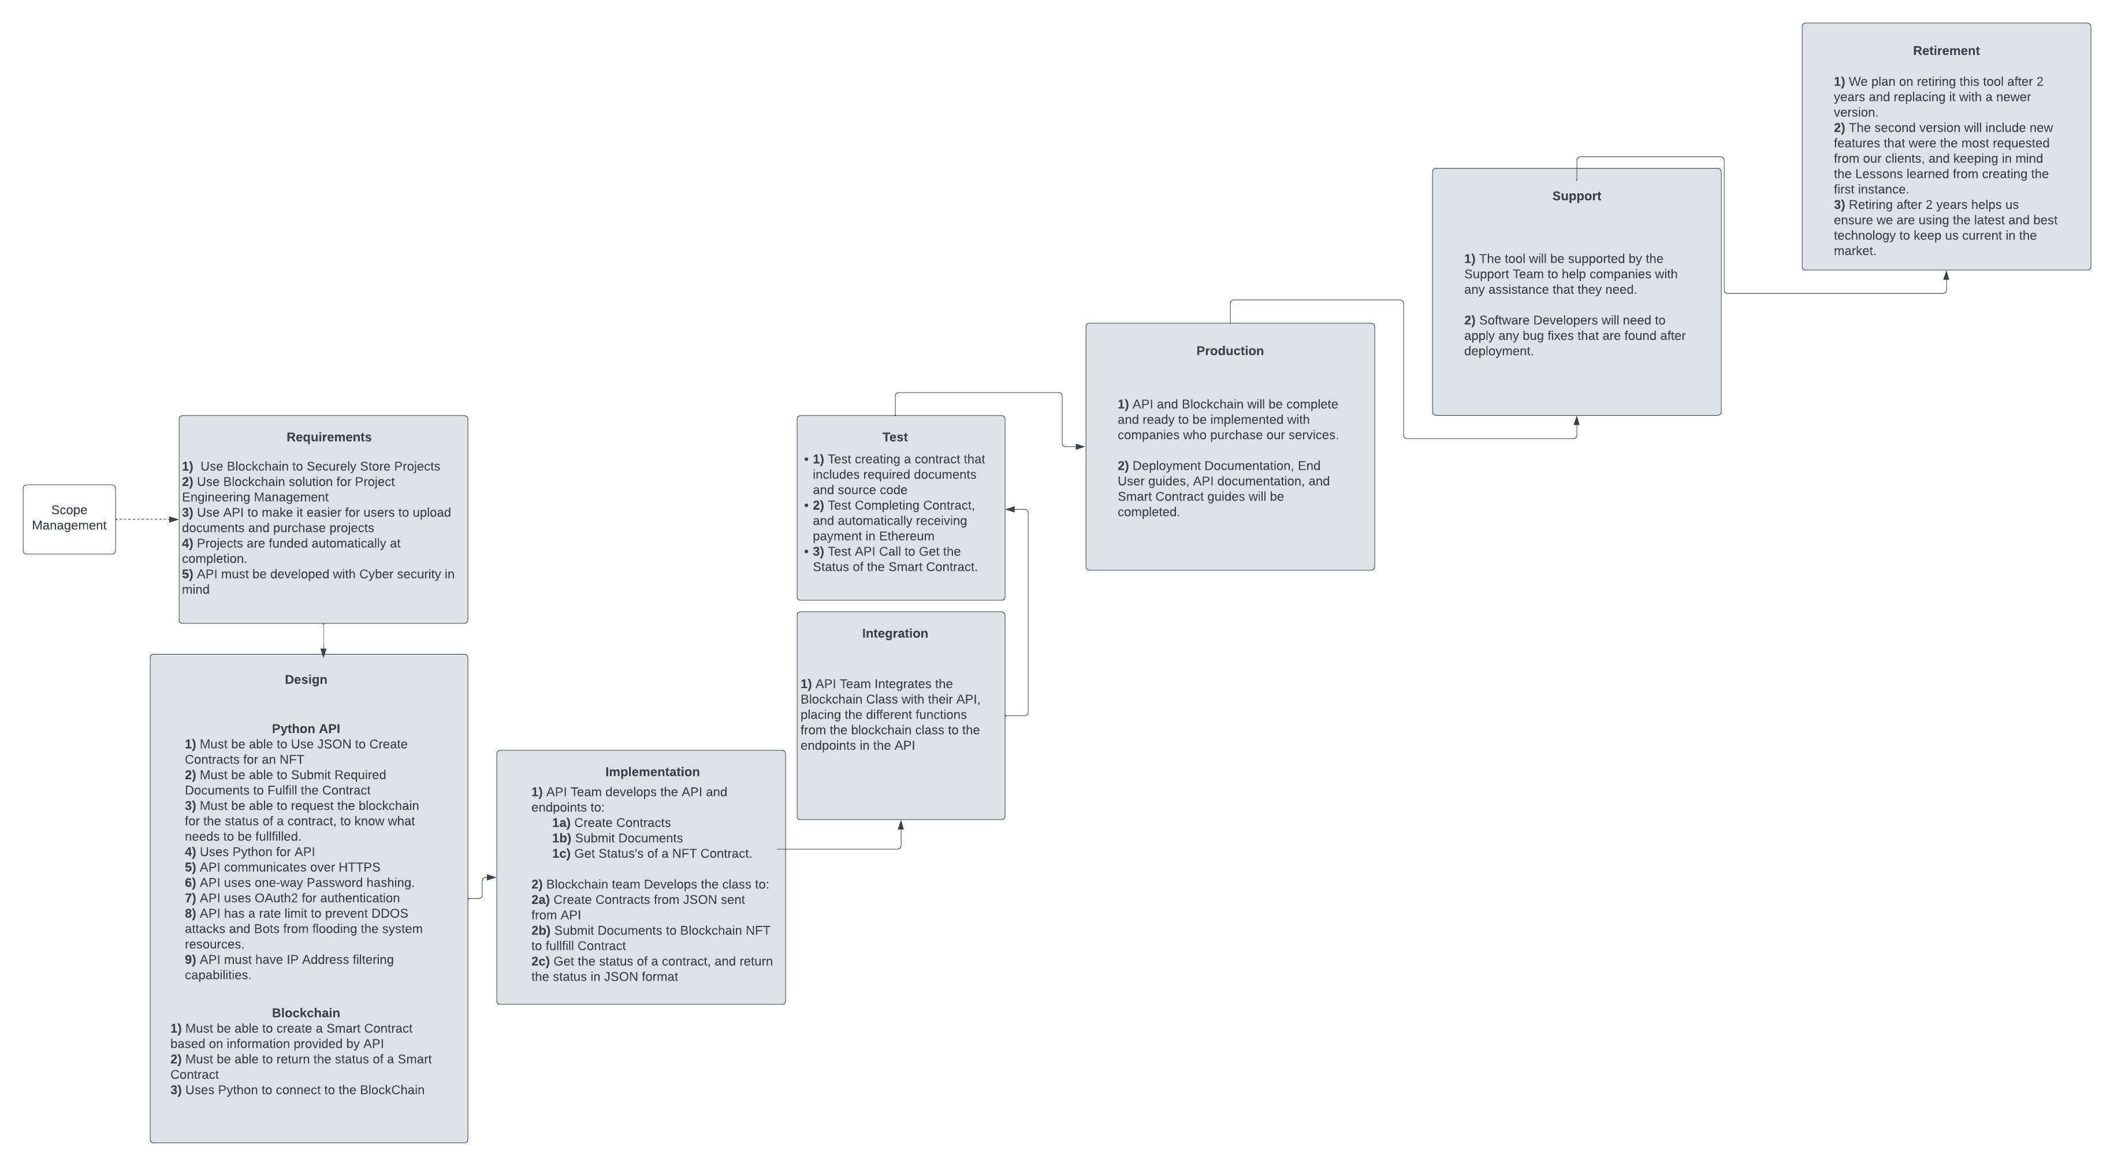
Product Lifecycle
Notes:
Requirements:
- We need to have a way to manage Projects by using Blockchain technology, by storing the Project and it’s required documentation as an NFT. Smart Contracts must be implemented with the created Project NFT’s, to manage the progress of a project, and ensure that a project is only funded when all requirements have been met. We also need to have an API Created, so that the parties who use this solution for project management can make their own custom Front-End website, which allows them to create Forms that help them build the Smart Contract, as well as the ability for the parties to display the progress of their projects in their preferred way.
Design:
- For the design of this solution, we will have a custom class in Python that will connect to the blockchain, and have the features to Create Smart Contracts, Submit information and Documents to fulfill the Smart Contract, and retrieve the status of a Smart Contract. The Functions should take JSON as inputs and return JSON as outputs. We will also need an API that has endpoints to Create Contracts, Submit information and documents to a Smart Contract, and Get the status of a particular Smart Contract.
Implementation:
- Our API Team will develop the endpoints to Create Contracts, Submit documents and required information to a contract, and Get the Status of a Smart Contract.
- Our Blockchain Team will develop a class in Python that connects to the blockchain, and have functions that create Smart Contracts, Retrieves the Status of a Smart Contract, and Submits Documents and Information to a Smart Contract. All functions within the class must take JSON as inputs and return JSON as the output. This is because this class will be utilized by the API.
Integration:
After the API team creates the API, and Blockchain team creates the Blockchain class, we will have the API Team include the created Blockchain class in their API, placing the functions of the Blockchain Class within the appropriate Endpoint. The Get Smart Contract Status endpoint will utilize the function to retrieve the status of a particular Smart Contract of a project.
Test:
We will test this solution by using the API to Create a Contract, which requires Source Code, Word Documents, PDF’s, and PowerPoint Presentations. It is important to include a variety of different documents, to test many different requirements that a Project Manager might assign as a requirement for a project.
In the Smart Contract, we need to include 1 ETH as the amount that is funded to the Teams wallet. This will require 2 ETH Wallets to be able to test.
We will then fulfill the created Smart Contract by submitting Source Code, Word Documents, PDF’s, and PowerPoint Presentations
After submitting each requirement of the Project to the Blockchain, we will use the endpoint to retrieve the status of the Project created.
When we complete the test Smart Contract, we should see that the Ethereum wallet that is associated to the Project should be funded with 1 ETH.
Support:
The Blockchain API solution will be supported by our support team for the next 2 years, and Developers who worked on this project will be responsible for handling any bugs that Support team is unable to resolve.
Retirement:
This version of the Blockchain API will be retired after two years being replaced with Version 2. Current customers will be eligible for a free upgrade to the second version.
We will keep the lessons learned from this project, as well as the feedback that has been received on what to be included in the next version.
Upgrading to a newer version helps to ensure we are using the latest and greatest technology, keeping us competitive in the market.

Slide 8
Scope Management

Slide 9
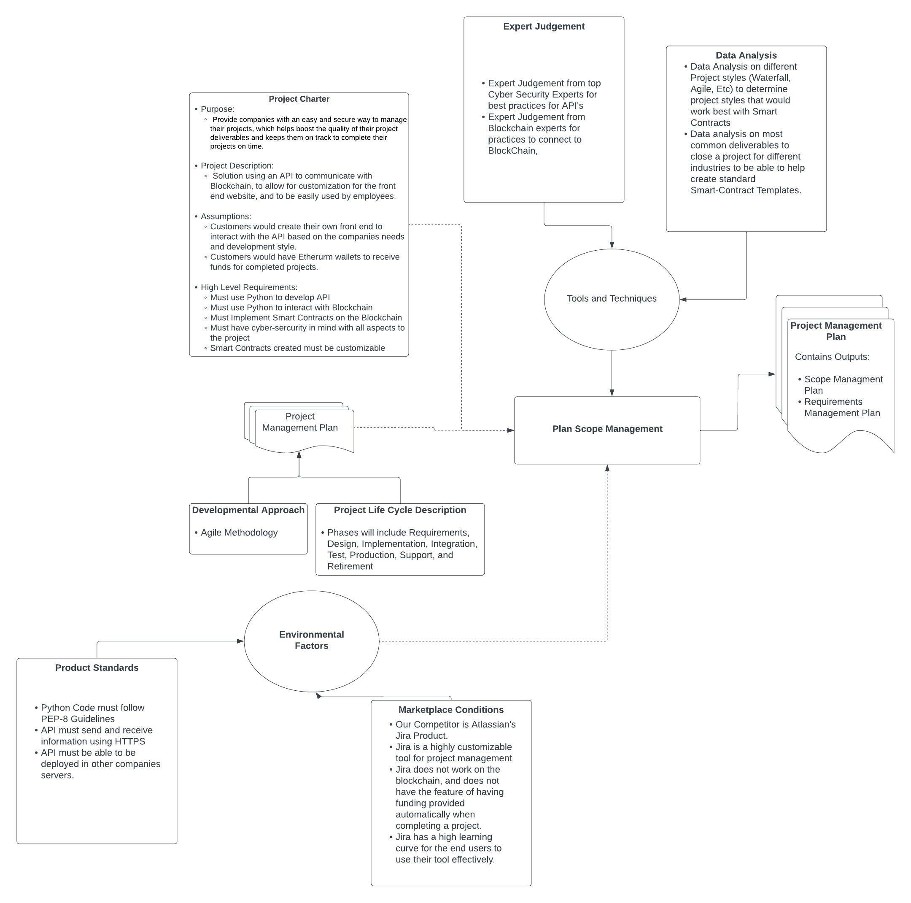
Scope Management
Notes:
The Project Charter, Developmental Approach, Project Life Cycle Description and Environmental factors are all inputs to the Scope Management.
Project Charter:
In the project charter, we are defining the purpose of this project, the project description, the assumptions, and the high level requirements.
Our purpose is to provide companies with an easy and secure way to manage their projects, which helps to boost the quality and keeps project managers on track to have their deliverables on time.
The description of the project is having a API to communicate with Blockchain, which allows for customization in a front end website to tailor to our customers needs.
The Assumptions are that the customers would develop their own front end website that tailors to the companies needs and project management style.
For the high level requirements, we must have cyber security in mind with all aspects of the project. Our clients value security highly, as they have proprietary information they want to have secure. Without the assurance of security with this product, we would consider the project to be a failure. We must also have the smart contract customizable to fit different projects needs.
Developmental Approach and Project Life Cycle:
The Developmental approach that is to be taken is going to be an Agile Methodology, with the phases “Requirements”, “Design”, “Implementation”, “Integration”, “Test”, “Production”, “Support”, and “Retirement” for the Product Life Cycle.
Environmental Factors:
We are considering the Environmental Factors while planning the scope management.
For our Project Standards, our Python code must adhere to PEP-8 guidelines for easily readable code. We are planning on creating future versions in the future, and having clean code is a standard we value, so developers have an easier time reading, and improving code. We must also use HTTPS to help ensure a secure API. The api that we are developing must also be able to be deployed on other companies servers. This is also to help address security concerns of our clients.
Regarding Marketplace conditions, our competitor is Atlassian's Jira Product. It is a highly customizable tool for project management, and has a front end included. Jira does have a steep learning curve for end users to use their tool effectively and does not work with blockchain. Using Smart Contracts to automatically fund a project in our project gives us a competitive advantage. Making our solution easy to use is important, as it will give us another competitive advantage.
Tools and Techniques used for Scope Management
Expert Judgement:
We will use expert judgement from our top Cyber Security Experts to gather best practices in creating Secure API’s, and Blockchain Experts for the best practices in connecting to blockchain using Python, and developing Smart contracts.
Data Analysis:
We will perform data analysis on different Project Management styles, such as Waterfall and Agile, to determine the most popular management styles in Project Management, as well as the best ones that would work with Smart Contracts.

Slide 10
Scope Inclusions
API
Get Methods to Get the Status of a Smart-Contract, Get Status of Multiple Contracts
Blockchain Connection Through Python
Connects to Blockchain
Creates Smart-Contract
Gets Status of Smart-Contracts
Adds information to Smart Contracts
Notes:
These are the Scope Inclusions of this project.
For the API, we will be including the Get Methods to Get the Status of a Contract, retrieve the status of multiple contracts, and retrieve documents submitted to a smart contract.
For the Python Class that connects to the Blockchain, Obtaining connection to the Blockchain, Creating Smart Contracts, Retrieving information from a Smart Contract, and adding information and documents to a smart contract are all within scope. Keep in mind that for all functions in the Python Class, they will all require JSON as Input and JSON as output. This is so that the API can effectively read the information that is being provided, as well as being able to submit the required information to the Python Class.

Slide 11
Scope Exclusions
API Methods Edit and Delete
Front-End Website that connects to API
Notes:
Front-end Website that connects to API.
The idea is to have our customers develop their own custom front end that connects to our API. Since our Customers will want to see the data provided by the API in various ways and have their Smart-Contracts defined with different required deliverables, we will be leading this up to the Customer.
API Methods Edit and Delete:
Due to the nature of Blockchain, information can not be edited or deleted (IBM Blockchain). Because of this, Edit and Delete Methods have been excluded from the Project’s Scope
References:
What is blockchain technology? - IBM Blockchain. IBM. (n.d.). Retrieved April 17, 2022, from https://www.ibm.com/topics/what-is-blockchain

Slide 12
Work Breakdown Structure
Notes:
The Project will be split into 2 key components, which is the API, as well as the Blockchain Class that is developed in Python.
The API will need to handle Authentication to the API, and the API must have the API Endpoints that include Get and Post Methods. The Get Methods will include Getting information on Completed Smart-Contracts, Getting the Status of Specific Contracts, and Getting the Status of all Contracts a user has access to.
The Post Commands will include Creating a Smart-Contract, and Posting Items to the Smart Contract, including Posting Documents, and Information that does not include a Document to be included in.
The Python Class for Blockchain will include making the Connection to the Blockchain, Creating Smart-Contracts based on the input provided in JSON Format, and Retrieving Details about a Smart-Contract that a User has access to View.
Documentation will also be created by the respective teams.

Slide 13
Change Request Process
Change requests go through the following Steps:
Submission of Formal Change Request
Determination of being within Scope of Project
Priority Assessment
Approval/Rejection
Notes:
Change requests will be handled in a 4 step Process
Submission:
- Submitter of the Change request must provide:
- Details of Change
- Added Benefit
- Why they are requesting the change
Determination of being within Scope:
Project Manager will determine if the Change Request falls within scope of the Project.
Priority Assessment:
Meeting will be held to discuss the priority of the change request into a category of “Need”, “Want”, or “Nice to have”.
Approval/Rejection:
The Change Request will be Accepted or Rejected in this step.
If Accepted:
We will decide on the action moving forward. If the Change request is in the “Nice to Have” category, the change will be included in the backlog, with the lowest priority.
References:
What is a change request and how to manage it. Tallyfy. (2020, February 26). Retrieved April 17, 2022, from https://tallyfy.com/change-request/

Slide 14
Inception Stage: 4 Month Timeline
Discovery of all Relevant Fields for Smart-Contracts
Prototype of a Smart-Contract
Prototype of Python Class that reads the information from the Prototyped Smart-Contract and formats the gathered data into JSON Format.
Prototype of Front – End Website that connects to an API.
Notes:
The Inception Stage is planned to take approximately 2 months.
Since the Smart-Contracts are going to be Implemented based on JSON Input, we need to come up with a list of all the different fields, documents, and deliverables that can be used for the Smart Contract. Fields could include Completion date, Acceptance Criteria for deliverables, Approval of Documents, etc. Since we want to have a high degree of customizability for the Contracts to be created, we need to have an extensive list of fields and accepted documents to tailor to all of our customers needs.
We will also have our Blockchain Experts create an example of a Smart Contract that can be used as an example.
We will also need a prototype of a Front-end website that can Create and Display information. This is to help determine how to have information displayed, how to set up our Forms for Submission of Documents, Creation of Smart-Contracts, and Pages that display information of the Smart Contract. It is important to focus on Functionality of the Site, and not on making the website looking pretty. Although we are not including a Front-End as our final product, we must need to understand how our end-users will use our product. This Prototype can also be used when we are performing User Acceptance Testing with some of our other internal teams. This front end can also serve as a great demo for the Sales Team, who are working to sell our product to prospective purchasers of the product.

Slide 15
Delivery: 3 Months
API Team to Deliver API
Blockchain team to Deliver Python Class that connects to Blockchain
Notes:
After our Inception Stage, we will begin the Delivery Phase, which we are planning 6 months for.
In the first month, the API team and Blockchain team will begin creating the Methods to Create and Read a Smart-Contract. Both teams will be sticking to the JSON Inputs and Output Structure that we decided was best in the Inception Stage.
The API Team will also be creating a front-end website to display the fields for the Creation of the Smart Contract, as well as the Initial Status of the Smart Contract when it is created.
In the first week of month 2, we will have the API Team implement the Methods that the Blockchain Created in the Python class with the API and perform initial testing.
Weeks 2, 3, and 4 of the 2nd Month, we will have User Acceptance Testing with 4 different Project Managers within our organization, to see if the API is working in a way that they would be able to use with their own Project Management. We will adjust scope and make any fixes based on the input from our testers.
Month 3, we will have the Development teams create the functions that allow for end users to submit information and documents in order to fulfill the contract.
Second week of Month 3, we will begin our User Acceptance Testing again with our internal Project Managers, to make sure that they can submit documents, and information to help fulfill the Smart Contracts that they have created in the previous UAT Cycle. Developers will adjust the functions based on User Input.
Month 4, We will have the development teams work on completing a Smart-Contract, where the specified parties will have funding transferred from one Ethereum Wallet to another.
Month 5, we will have extensive user acceptance testing with our product, introducing more Internal Project Managers to User Acceptance Testing, and making adjustments for any flaws that are discovered. The main focus for this month is to wrap up any other Error Handling that may have been missed previously, making sure that the product is error proof, and is easy to use.
Month 6, we will be publishing the Final Release, wrapping up all documentation for usage, and prepare our Sales Teams with the knowledge required to Sell our Product and present a demo to showcase the Products capabilities. Our Support team will be provided with all documentation for usage of the product, common mistakes, Frequently Asked Questions, and other documentation that will allow them to provide assistance to our clients.

Slide 16
Maintenance: 2 Years
Support Ticketing System for our Support Team to manage
Tickets escalated to Developers if Support team is unable to resolve the issue ticket.
Development Team will implement Bug fixes to the product for any encountered Bugs.
Notes:
Our Support team will be handling Customer Support, helping them use the tool, and providing any assistance that our Customers would need for them to reap the benefits of the created Product.
Our Developers will support any issues that arise that the Support team is unable to handle. The Support team will have a ticketing system to help handle all the Customers issues that they encounter. If the Support team finds issues that they are unable to handle, the issues will be escalated to the Development team to provide fixes for the issues that they come across.

Slide 17
Gantt Chart

Slide 18
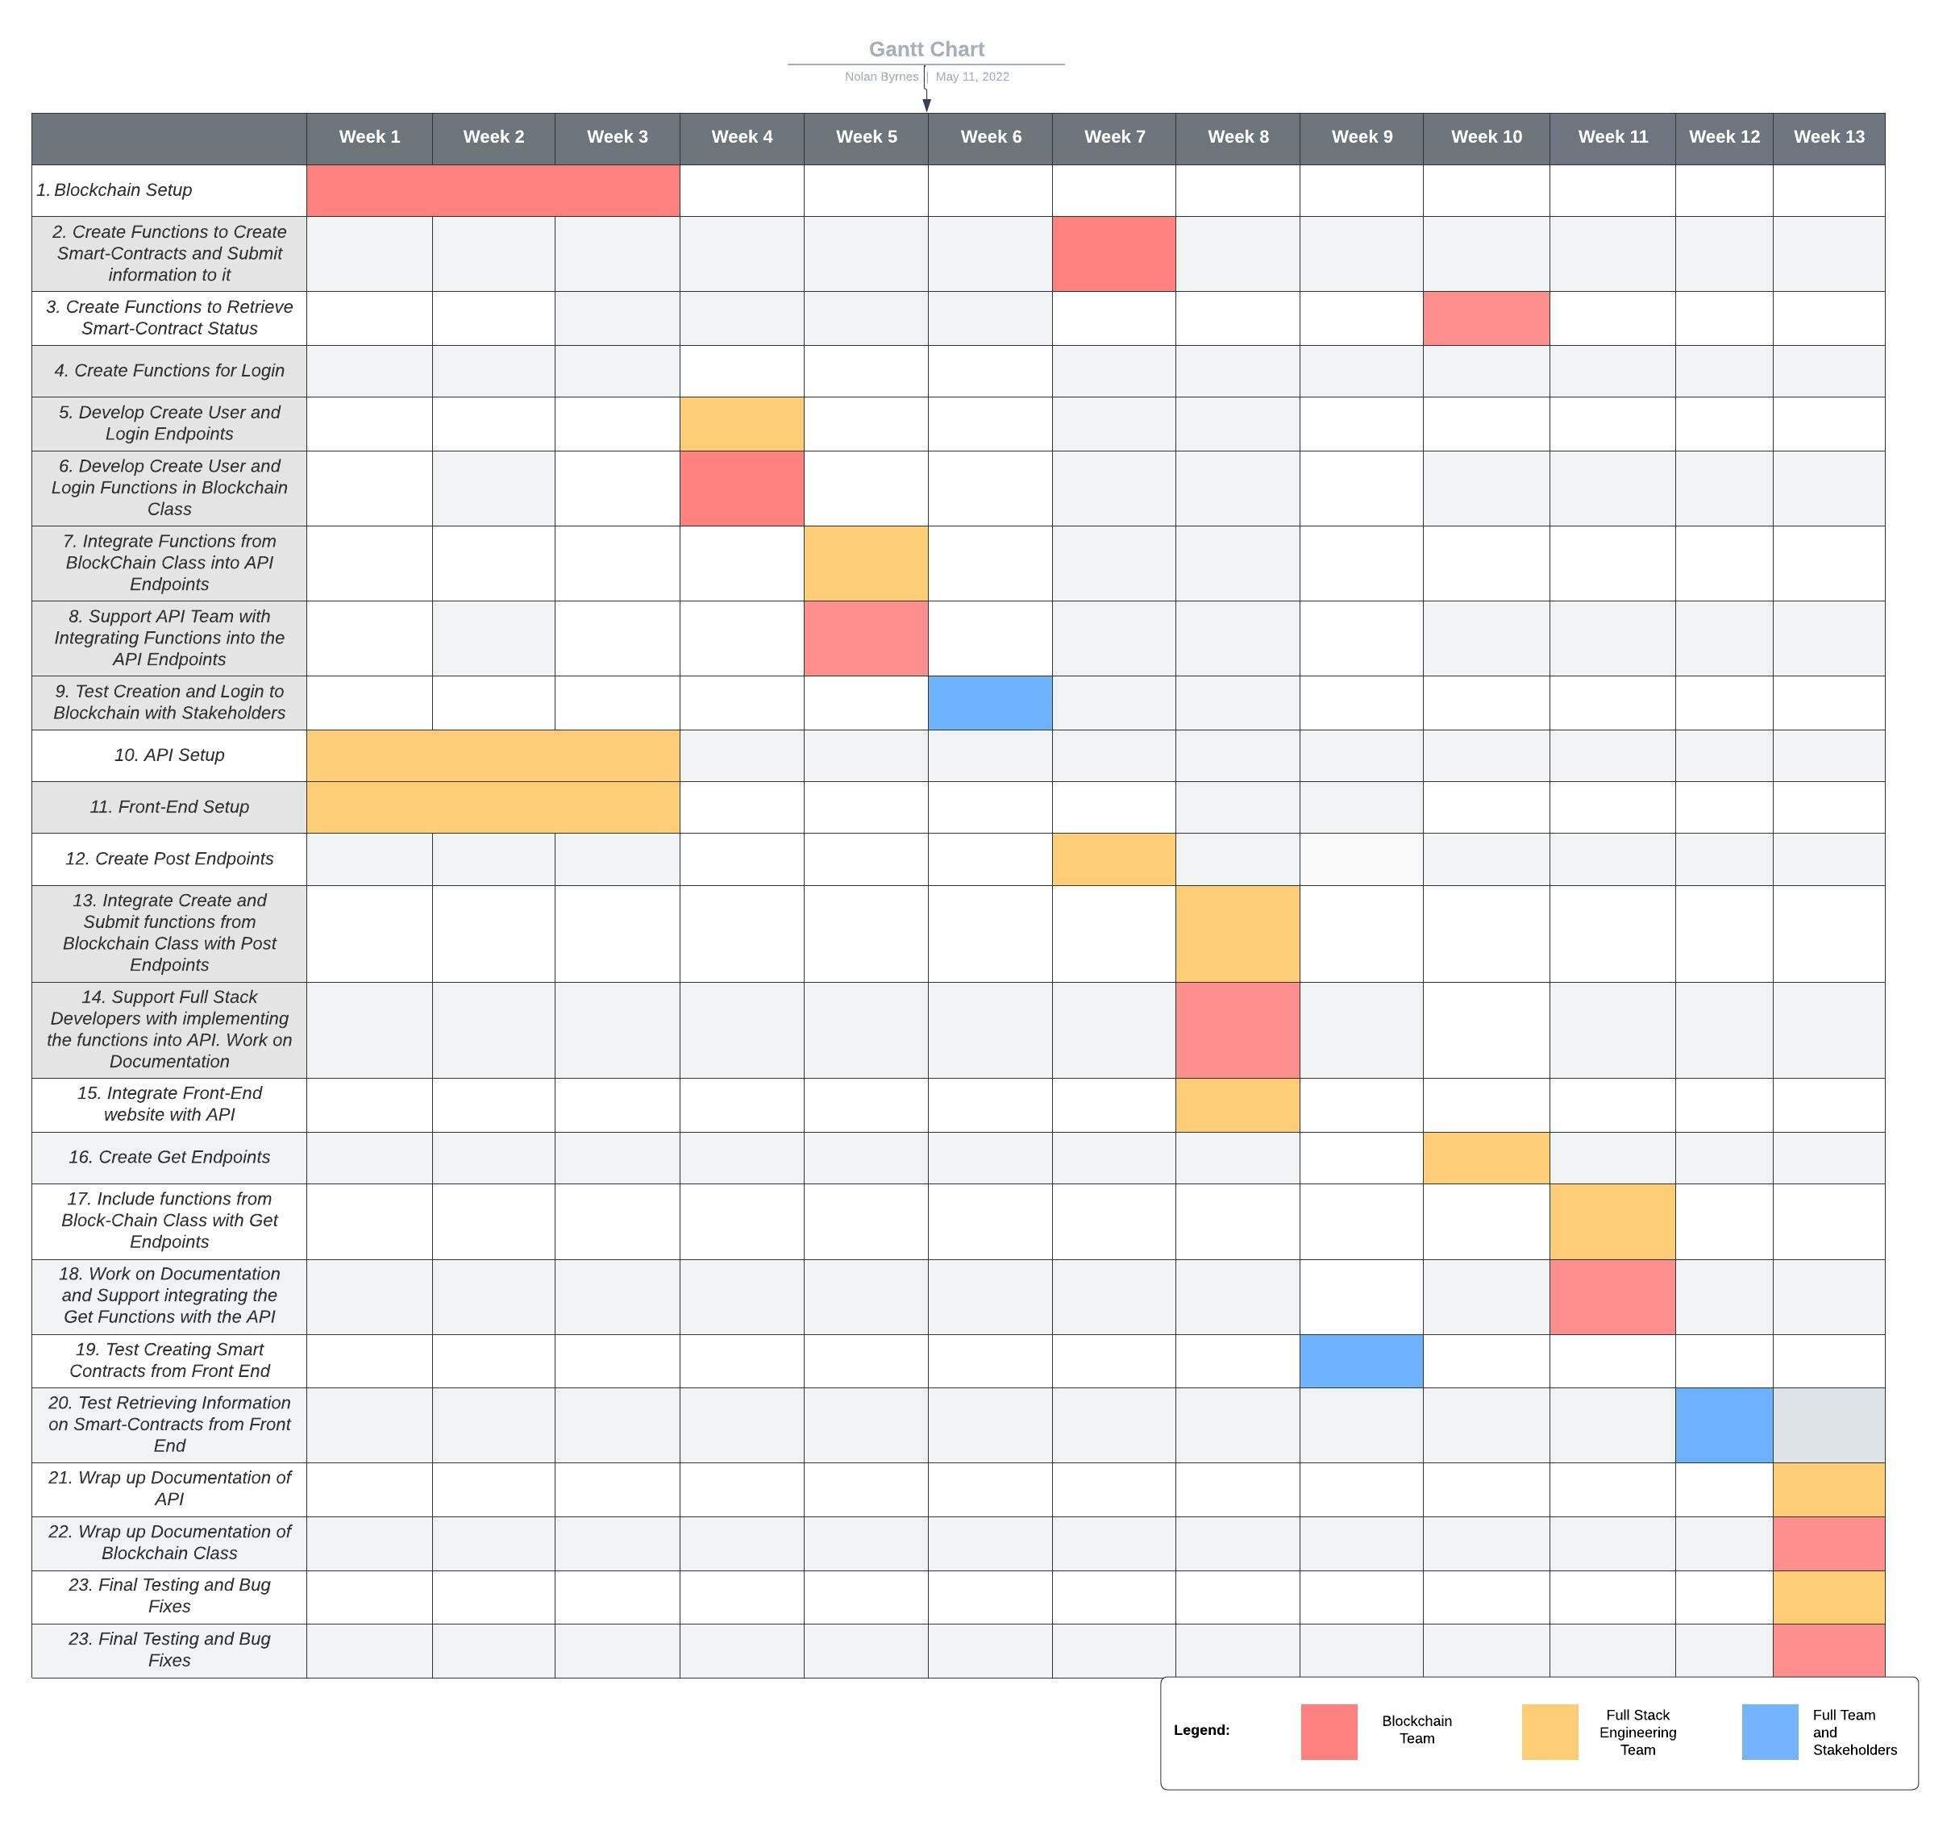
Gantt Chart

Slide 19
Gantt Chart: Weeks 1-3
Blockchain Setup – Blockchain Team
API Setup – Full Stack Development Team
Front-End Setup – Full Stack Development Team
Notes:
API Setup:
- This will be handled by the Full Stack Development Team. They will be developing the basic structure of the API, including the Authentication of the users, having the API Server Running, and creating the Get and Post endpoints. For the Get and Post Endpoints, they just need to have the endpoints available, to serve as a placeholder for the development in the next couple weeks.
Front-End Setup:
- This will also be handled by the Full Stack Development Team. They will Create a page for Login, Creating a Smart-Contract, and a form to post documents and information to the submission form.
At this point, the pages will be static, as we have not integrated or developed all the features at this stage.
Blockchain Setup:
- Blockchain Team will begin developing the BlockChain Class using Python and will create stubs for all of the functions to be completed with this project.

Slide 20
Gantt Chart: Week 4
Create Create User Endpoints – Full Stack Development Team
Create Create User Functions – Blockchain Team
Create Login API Endpoints – Full Stack Development Team
Create Login Functions – Blockchain Team
Notes:
Full Stack Development Team:
- They will create the endpoints to Create and Log into a User account.
Blockchain Team:
- They will create functions that can be used to Create and Log into a User account.
- For Creating Users, they must help facilitate the creation of an Ethereum Account

Slide 21
Gantt Chart: Week 5
Integrate Functions from Blockchain Class into API Endpoints
Notes:
Full Stack Development Team:
- They will integrate the Functions from the Blockchain Class with the Create Account and Login Endpoints.
- They will also be integrating their API function calls with the Front-End web site for the Create and Login Screens.
Blockchain Team:
- They will support the API team in the integration and make any changes if there are any mistakes with their functions.
- They will also be able to help verify if accounts are being created, and users are being logged in.
- Blockchain team will help with API Team with any questions that they have about logging in, or creating accounts on Blockchain.

Slide 22
Gantt Chart: Week 6
Test Creating Account and Logging into account with Stakeholders
Notes:
Week 6, we will be testing the “Create User” and “Login” functions with our Stakeholders and End Users.
We will have both our Full Stack Developers, as well as our Blockchain team involved in this week.
Blockchain and Full Stack Development teams will make any changes needed due to discovered bugs for the Create and Login Process.
Both the Blockchain and Full Stack Development Teams will also verify that the Create and Login User functions are working by verifying with their logs.
We will collect feedback from the end users on how to improve the Login Process, and if there are any suggested changes.

Slide 23
Gantt Chart: Week 7
Create Functions to Create Smart Contracts and Submit Information to Smart Contracts
Create Functions to assign user to a Smart-Contract
Create End points that create and submit information to a Smart-Contract
Notes:
Blockchain Team will develop functions to create Smart-Contracts, as well as to submit information to a smart contract.
For the Creation of Smart Contracts, they must be able to include all of the possible fields that we agreed upon, and also be able to add viewing permissions into the contract. This is so only the relevant parties to a smart contract can view it.
Blockchain team must also remember that the inputs to these functions are in JSON format.
API Team will create the Endpoints that submit the information for logging in and creating users.

Slide 24
Gantt Chart: Week 8
Integrate Create and Submit functions from Blockchain Class with Post Endpoints
Integrate Front-End website with API
Blockchain Team supports the Full Stack Developers with integrating the Create Functions with the API.
Blockchain Team to work on documentation
Notes:
Full Stack Engineering Team will integrate the functions created by the Blockchain Team to Create Smart Contracts and Post Information to a Smart Contract.
They will also be integrating the Create and Submit Documents/Information Pages of the Website to the API functions that they created.
Blockchain team will support the Full Stack Engineering team in helping with initial tests, confirming that the Smart-Contracts are being created, and that conditions of the Smart-Contract are being fulfilled during initial tests.
Blockchain Team will also work on creating documentation and guides for our end users.

Slide 25
Gantt Chart: Week 9
Test Creating Smart Contracts from Front End with stakeholders and end users
Notes:
Week 9, we will be testing the “Create Smart Contract” and “Post Document to Smart-Contract” functions with our Stakeholders and End Users.
We will have both our Full Stack Developers, as well as our Blockchain team involved in this week.
Blockchain and Full Stack Development teams will make any changes needed due to discovered bugs for when creating a Smart-Contract and posting a document to a Smart-Contract.
Both the Blockchain and Full Stack Development Teams will also verify that the Create Smart Contract and Post Item functions are working by verifying with their logs.
We will collect feedback from the end users on how to improve the Smart-Contract Creation Process, and if there are any suggested changes.

Slide 26
Gantt Chart: Week 10
Create Functions that retrieve the Status of Smart Contracts - Blockchain Team
Create Get Endpoints – Full Stack Developers
Notes:
Blockchain team will create functions that retrieve data regarding a Smart Contract. These functions should be set in a way where we are able to perform different types of searches to retrieve the information needed based off the JSON input that it receives from the API Call.
Full Stack Engineers will develop the API Get Endpoints which retrieves information about the Smart Contracts that the user has access to. The Get functions should be able to search and filter contracts based on what the user is looking to see based on the search criteria provided by the end user.

Slide 27
Gantt Chart: Week 11
Full Stack Engineers will Implement the Get Functions created by the Blockchain Team within their Get Endpoints.
Full Stack Engineers will create a Search Page in the Front end, and have the search filter’s match what can be implemented with the Get Request
Blockchain Team will support the Full Stack Engineers
Notes:
Full Stack Engineers will implement the functions that the Blockchain team has created to work with their Get Endpoints that they created.
Full Stack Engineer’s will also implement the API Function’s within the Front-End Site that has been created, to allow for users to put in Search Criteria, and display the information that is retrieved on the page.
Blockchain team will support the Full Stack Engineer’s to make sure that the API Call’s and the Functions are working together.
They will also be able to help troubleshoot issues if there are any errors with Blockchain.
Blockchain team will also work on documentation and end user guides, to help the end users understand how to use the product.

Slide 28
Gantt Chart: Week 12
Test Retrieving Smart Contract Information with Stakeholders and End Users
Both the Full Stack Engineers and the Blockchain team will be involved with testing with stakeholders.
Notes:
This week, we will Test the features of Retrieving Information on Smart Contracts with the end users. Full Stack Engineers will support to fix any bugs that are occurring during testing and will receive feedback from the stakeholders and end users.
It is important to note that we will NOT be taking any requests to change the Front end of the web page, as it is not included in the final product, and it is up to the end users to create the websites to suit their needs. If there is a specific filter that is not covered with the search criteria, then we can have it considered to be implemented.

Slide 29
Gantt Chart: Week 13
Wrap up Documentation of API and Blockchain Class
Final tests and bug fixes
Notes:
-This week is dedicated to wrapping up the project. This week, our Full Stack Engineers and Blockchain team will be wrapping up documentation for the customers, as well as internal documentation on how the API works. Teams will be performing their final tests on the final product and make any fixes that need to be made.
- Instructional guides for setup and usage will also be created and distributed to the Support Team.
- Full Stack Engineers and Blockchain team will be recording all their lessons learned for the project.

Slide 30
Risk Management
Nolan Byrnes

Slide 31
Risk Matrix
Notes:
R1: Volatility of Ethereum
R2: Hacked Ethereum Wallets
R3: Government Banning of Blockchain
Above is our Risk Matrix, and as you can see, Hacked Ethereum Wallets and Ethereum’s volatility poses the greatest threats to our API, with both being in the red zone.

Slide 32
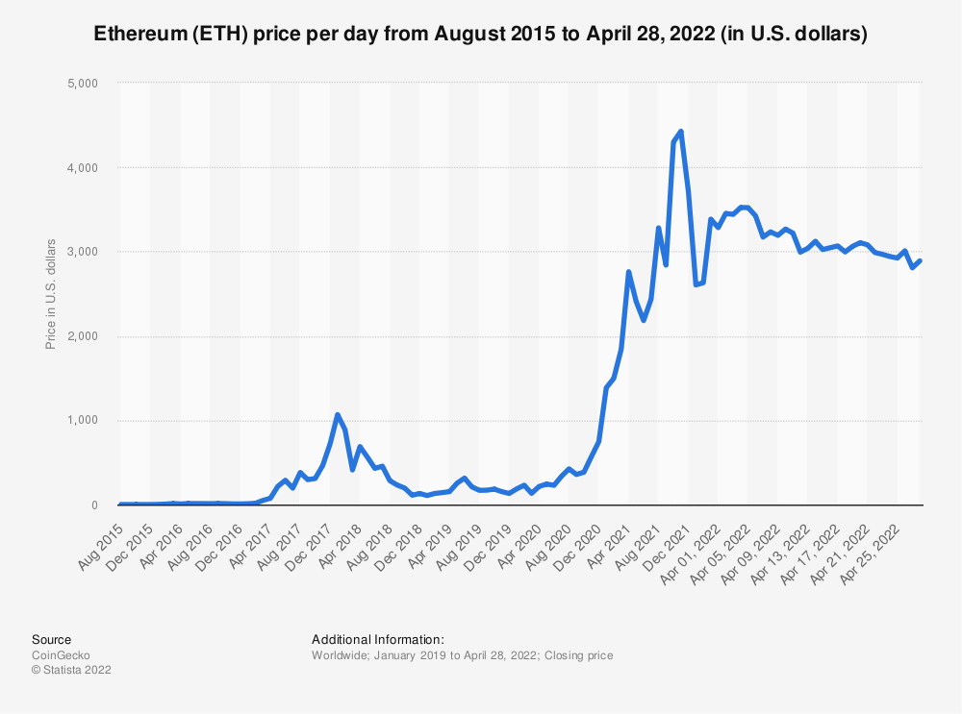
Volatility of Ethereum
Volatility of Ethereum is higher than typical Fiat currencies.
This may discourage the use of Smart-contracts to complete financial contracts
Creating Smart-Contracts could affect the creation of projects based on the price of Ethereum.
Notes:
Volatility of Cryptocurrencies, like Ethereum are volatile assets. This could affect our users who are providing funding for projects. Since Smart-Contracts can not be altered, the ones who are purchasing the completed projects may not want to create the Smart-Contract until the price of Ethereum is low. Furthermore, it would motivate the parties involved in the work that the smart-contract assigned to finish the project when the value of Ethereum is high, and not be as motivated to complete a project when the value is low.
Due to this possible scenario, there may be companies who are hesitant in purchasing the API, or renewing contracts.
References:
Best, R. de. (2022, April 28). Ethereum Price history 2015-2022. Statista. Retrieved May 1, 2022, from https://www.statista.com/statistics/806453/price-of-ethereum/

Slide 33
Ethereum Hot Wallets being hacked
There is a risk of Ethereum Hot wallets being hacked
Using the Smart Contract API would require a Hot wallet
Companies using our API may have their wallets hacked
Notes:
The main selling points for the API is that it is secure and can automatically execute payments when all terms of the contract are completed. Having one of our customers hot wallets hacked would decrease interest in using our platform, as it could be viewed that our product is not secure.
Cryptopedia states “A hot wallet is connected to the internet and could be vulnerable to online attacks — which could lead to stolen funds — but it’s faster and makes it easier to trade or spend crypto.”(Cryptopedia, 2022, para. 2 ). They also explain that a cold wallet is not connected to the internet, which is more secure, and a safe way to store cryptocurrency.
In order to mitigate this risk, we should have an introductory course to cryptocurrency and share best practices for our clients and emphasize only putting on the amount that they need for transactions on a Hot Wallet and storing most of their coins on a cold wallet.
References:
Cryptopedia Staff. (2022, March 10). Crypto wallets: Hot vs. cold wallets. Gemini. Retrieved May 1, 2022, from https://www.gemini.com/cryptopedia/crypto-wallets-hot-cold

Slide 34
Government banning of Blockchain
There are countries where Ethereum is illegal, such as Afghanistan, Saudi Arabia, and Pakistan.
Other countries may also ban Ethereum.
We would need to be sure that we do not extend our services to countries where Ethereum is illegal and discontinue support for companies who are operating in countries where Ethereum is illegal.
Notes:
There are currently countries that ban the use of Ethereum, such as Afghanistan, Saudi Arabi, and Pakistan (Moffatt, 2022, para. 10). There is a risk of other countries following suit and banning the use of the Ethereum network. If this happens, we will be unable to continue business in the countries where Ethereum is banned.
We would need to discontinue contracts with our clients who are operating in countries where Ethereum is illegal, and not promote our services in those countries either. It is possible for our clients to use a Tor network to help prevent them being detected, but as our company policy, we do not want to get ourselves in illegal behavior and adhere to all local laws where our services are being used.
References:
Moffatt, N. (2022, March 2). Is Ethereum Legal? (and countries where it's not). The Financial Geek. Retrieved May 15, 2022, from https://thefinancialgeek.com/blog/is-ethereum-legal/

Slide 35
Risk Management: Mitigation Plan
Approaches to decrease likelihood of risk from occurring
Approaches to decrease the impact of the risk
Dispositions of Risk:
Accept
Mitigate
Transfer
Share
Notes:
For Risk Management, Siegel suggests that a mitigation plan must be developed for the risks identified, which highlights approaches that can be taken to decrease the likelihood of the risk from occurring, as well as approaches to decrease the impact of the risk, in cases where one of the risks come to pass (Seigel, 2019, pg. 236). Having a plan to mitigate the risks will help to increase the likelihood of the project's success. Siegel also highlights the four potential responses that can be taken for any identified risk, also called the dispositions of risk, which are to Accept, Mitigate, Share, or Transfer the risk.
By accepting the risk, we are accepting the probability of the risk occurring and accepting the consequences. Seigel mentions that when we accept a risk, we still should reserve the right to change our mind on how to mitigate the risk on a future date (Seigel, 2019, pg. 236).
By mitigating the risk, we can mitigate the risk in either the probability of the risk from occurring and the impact the risk affects our project. Risks can be mitigated though the design of the software, or assigning individuals to help mitigate the risks.
Seigel warns that sharing or transferring risk could affect help the company save money, and help to alleviate the financial burden, however, by transferring or sharing risk, it may negatively impacts the companies reputation. (Siegel, 2019, pg. 237). As a company, we want to keep a great reputation with our customers, so for any instances that we transfer or share risk, we will also be using any actions that we can to help mitigate the risks as well.
References:
Siegel, N. G. (2019). Engineering Project Management. Wiley.

Slide 36
Mitigation Plan: Volatility of Ethereum
Disposition of risk: Mitigate
Make auto-payment of Etheruem at close of Smart-Contract optional
Notes:
For the volatility of the price of Ethereum, we understand that there is little that we can do to prevent the cryptocurrency from being volatile, and we can not manipulate the price of Ethereum either. To mitigate the risk of volatility, we can have it to where auto-payment of Ethereum at the close of a contract is optional. This is so that if companies are not comfortable with the volatility of the cryptocurrency, they can choose to have payments of completed projects in the best way they see fit. This will put the responsibility of sending/receiving payment to the customer using our Blockchain API solution but will allow them to avoid volatility of the crypto market, without losing the main benefits that our solution offers.
We can also remind customers that over the long term, Ethereum is projected to increase in value, and holding their Ethereum assets over time will accumulate value, and a great hedge over the inflation of fiat currencies. This is an important note that the sales team must inform potential customers. This will help reduce the hesitancy of using our blockchain solution for their project management and is a great selling point.
If Ethereum becomes too volatile, we would send out reminders to all our customers that the auto-payment feature of Ethereum is optional, and they can still use our solution for their project management.

Slide 37
Mitigation Plan: Ethereum Hot Wallets Hacked
Disposition of risk: Mitigate
Provide best practices to customers
Restrict Hot-wallet information from being retrieved in API’s Get Requests
Restrict Smart-Contract Creation to Project Managers
Log users interactions with API
Notes:
We would mitigate the risk of having Ethereum Wallets being hacked by providing all our customers a best practices guide for their hot and cold wallets. It would include tips such keeping their Ethereum reserves in a cold wallet, and only transfer what they need into the hot wallet, which is easily accessible. We would remind them that a hot wallet should be treated like a checking account, whereas a cold wallet is like a savings account.
Also, when the API is providing the user information about any Smart-Contract, it will only display the last four digits of the Hot Wallet’s account, and that would only be for users who have an elevated level of access to the smart-contract, such as the Project Manager. Doing so will prevent individuals from acquiring hot wallet information that they could use to steal from. We can also have our API Solution log users' interactions with the API, to help identify and address suspicious behaviors coming from users that are interacting with the API. This will help to discourage bad actors from attempting to acquire information they are not supposed to, and flag for suspicious behavior.

Slide 38
Mitigation Plan: Government banning Blockchain
Disposition of risk: Mitigate
Provide our Blockchain Project management solution to government agencies
Run campaigns to help spread awareness of the benefits of blockchain technologies
Keep close relationships with members of congress.
Move to crypto-friendly country, and redirect our efforts in case that Government makes blockchain technology illegal
Notes:
To mitigate the risk of Government banning blockchain technology, we will make efforts to advertise and show others the value that can be achieved by using blockchain technology. We will also be sure to maintain a close relationship with members of congress and run campaigns to help spread awareness of what blockchain is. When people think of blockchain, they think of it as just a decentralized banking system, so it is important to have the public know the other benefits that blockchain can be used for. We can also give our Blockchain API solution to a government agency at a reduced price, and have our solution used within government agencies. Our blockchain API solution has security in mind, which could be an excellent use case for top secret projects that government agencies work on. Having our solution being utilized within government will make it more difficult for government for begin to ban blockchain, as it would be expensive for the agencies that use our solution to discover and implement new solutions to help with their project management for top secret projects.
In the event that the Government does make blockchain technologies illegal, we would move our company to a cryptocurrency-friendly country and focus our sales to companies who do business where our software could be legally used.

Slide 39
Stakeholder Management
Nolan Byrnes

Slide 40
Stakeholder Engagement Assessment Matrix
Stakeholder | Power / Interest | Unaware | Resistant | Neutral | Supportive | Leading
Customers | Low / High | C |  |  | D
Government | High / Low | C |  |  | D
Blockchain Team | Low / High |  |  |  | C D
Full Stack Development Team | Low / High |  |  | C | D
Notes:
In the Stakeholder Engagement Assessment Matrix, we have three identified Stakeholders. Our customers, the government, and our blockchain team.
For reference, any columns that have a “C”, resemble the Current level of engagement of the stakeholder of that row. “D” resembles the desired level of engagement we want to have with each of the stakeholders identified.
In the Power / Interest column, you will see the level of Power and Interest that each of the stakeholders contain. Power resembles how much influence that they have towards the project. Interest is gauged based on the impact the project has, and accountability that the stakeholder has in the project.
The following slides go into more detail about the stakeholders listed in the above Stakeholder Engagement Assessment Matrix.

Slide 41
Customers
Power
Low
Interest
High
Current Level of Engagement:
Unaware
Desired Level of Engagement:
Supportive
Challenges:
Unfamiliarity of Blockchain
Volatility of Ethereum
Notes:
Our customers are other organizations who are looking for a secure way to handle their project management. Since this is a new product that we are offering, they are currently unaware of this project.
The customers have a low power in influencing the project but will have a high interest when they hear about what we are doing. Jersak claims that stakeholders who have low power but high interest “need to be kept informed and solicited for input from their constituents, but are not selected for their ability to influence main project outcomes” (Jersak, 2020, para. 6).
The reason why we have the customers labelled as low power is because we want our end product to serve the masses, and not just one individual customer. Most of our customers handle Project Management differently, and by allowing to have a customer have a high level of power of this project, we could potentially be reducing the number of customers who would be able to use our final product. It is important to receive their feedback and keep their suggestions under consideration and keep them informed of the progress of the project, to keep them interested in our product, which would ultimately lead to them purchasing the final product.
The challenges we may face may include the general public having unfamiliarity with blockchain. They may see Ethereum just as a cryptocurrency, and not understand the benefits that they can gain by using Smart Contracts on the Ethereum Blockchain. We will need to educate our potential customers about what Smart Contracts are, and how they work on the Ethereum Blockchain.
Also, customers might be hesitant in getting involved due to the volatility of Ethereum. Companies would rather use a currency that has stability, so they do not feel cheated when they finish a project when the price of Ethereum is down.
References:
Jersak, M. (2020). Stakeholder analysis – a practical example from a successful project. People First Project Management. Retrieved May 8, 2022, from https://peoplefirstprojectmanagement.com/stakeholder-analysis-a-practical-example-from-a-successful-project/

Slide 42
Government
Power
High
Interest
Low
Current Level of Engagement:
Unaware
Desired Level of Engagement:
Supportive
Challenges:
Government Interest in making blockchain technologies illegal
Notes:
The Government is a stakeholder who has a high level of power in the success of our project, and low interest. If Government makes blockchain technologies illegal, we will be unable to successfully complete this project. Jucan claims that stakeholders who have high power and low interest “need to be kept satisfied and apprised of project progress, but do not impose their influence on day-to-day project execution or system functional requirements” (Jucan, 2021, para. 7). We need to be sure that we are following the governments laws, and inform them of what our project is, as well as what benefits it brings.
The Government is also currently unaware of the project, and once they hear about what we are doing, they are likely to be in the Resistant category initially. Noone claims that “cryptocurrencies undermine central banks’ ability to use monetary policy to fix the problem underlying the currency depreciation, and diminish their influence over investment, spending, or inflation within their jurisdictions” (Noone, 2021, para. 10). Government does have a concern with the rising popularity with Cryptocurrency and may be working on laws that may render our product useless. Jucan claims that most resistant stakeholders are well intended, but their reluctance is derived from a lack of accurate information. Informing our Government Officials about the benefits our project provides, and how the product can benefit them could potentially steer them into a supportive level of engagement, or at minimum, neutral.
Once government hears us mention the use of Ethereum and Blockchain with our project, they may be resistant, but by highlighting the benefits, and how our project can benefit them, we may be able to have their support in the project and reduce the risk of having the technology we are using from being illegal.
References:
Jucan, G. (2020, February 5). Resistant stakeholders: Dealing with the good, the bad and the ugly. Resistant Stakeholders: Dealing With the Good, the Bad and the Ugly George Jucan - February 5, 2020. Retrieved May 4, 2022, from https://www.projectmanagement.com/articles/609128/Resistant-Stakeholders--Dealing-With-the-Good--the-Bad-and-the-Ugly
Noone, G. (2021, May 17). The case against bitcoin: Why governments are cracking down on crypto. Tech Monitor. Retrieved May 8, 2022, from https://techmonitor.ai/policy/digital-economy/case-against-bitcoin-governments-plan-cryptocurrency-ban

Slide 43
Blockchain Team
Power
Low
Interest
High
Current Level of Engagement:
Supportive
Desired Level of Engagement:
Supportive
Challenges:
Bad actors may try to exploit the project for their own personal gain.
Blockchain team may feel empowered to lead the project due to them being the experts in blockchain technologies.
Notes:
The blockchain team is developing the back end of our project using Python to connect to the blockchain and creating smart contracts. They are enthusiasts of Ethereum, and excited in having the role to create a blockchain solution for project management with the Ethereum Blockchain.
The blockchain team is currently supportive of this project, and they are at the desired level of engagement. If they progress to a leading level of engagement, we need to make sure that we keep the team in check, clearly defining their roles and responsibilities in the project. They may feel like they have more power than they have over the project, because they are responsible for creating the Python Class that interacts with Ethereum's Blockchain. Them knowing that other parties may not know as much as them about blockchain technology may have them feeling like they have more power than they possess in the project.
The challenges that we may face with our blockchain team is that since they are the ones who are developing the program that interacts with Ethereum’s blockchain, they know more about how it works more than anyone else, which means they also know about the vulnerabilities, and how to exploit it. We do not want to have a situation where one of our own developers becomes a bad actor who exploits the software that we release for their own personal gain. Since our solution involves Ethereum wallets, and the other teams involved not having the same amount of knowledge as they do, there may be some who believe they can get away with exploiting our software. We need to be sure to have a close eye on the code that they are producing by having code reviews and keep an eye on each of the team members, keeping note of any suspicious activity.

Slide 44
Full Stack Development Team
Power
Low
Interest
High
Current Level of Engagement:
Neutral
Desired Level of Engagement:
Supportive
Challenges:
Bad actors may try to exploit the project for their own personal gain.
Team may feel overwhelmed with having to work with Blockchain.
Notes:
The Full Stack Development Team is responsible for creating the API that works with the Python Class that the Blockchain team is creating, to generate and complete Smart Contracts.
This team currently has a neutral level of engagement, because they feel a little overwhelmed with working with blockchain, which is a newer technology that they have not used before, but they are excited to be working on the project to create a more secure and efficient way to deal with Project Management. Educating them more on how blockchain works, and how using blockchain makes the smart contracts secure will help them move to the category of Supportive engagement. It is also important to make sure that the Blockchain team helps to educate them through the process of this project, to help give them a better understanding on how to interact with the python class that they are developing.
Much like our Blockchain team, our full stack developers are developing the program that interacts with Ethereum’s blockchain and will know more about the vulnerabilities, and how to exploit it. We do not want to have a situation where one of our own developers becomes a bad actor who exploits the software that we release for their own personal gain. Since our solution involves Ethereum wallets, there could be interest to exploit the API to gather information that they should not have access to. We need to be sure to have a close eye on the code that they are producing by having code reviews and keep an eye on each of the team members, keeping note of any suspicious activity.

Slide 45
Project Closure

Slide 46
Closure
Obtain Acceptance in Writing
Document Lessons Learned
Produce a Closeout Report
Close Contracts
Archive Project Information
Notes:
Biafore mentions when closing a Project, you need to complete the tasks of Obtaining Acceptance in Writing, Documenting the Lessons Learned, Produce a Closeout Report, Close Contracts, and Archive Project Information (Biafore, 2019, sec. 58).
To gain the acceptance in writing, we will have the Team Leads from the Full Stack Development team, and the Blockchain Development Team to Sign a document stating that all of their items from the Work Breakdown Structure have been completed, and all of their code has been thoroughly tested, without any identifiable bugs within the software that has been produce. This will help with accountability on the respective teams, to make sure that all items are complete, and it is a formal way to state that all of the work has been completed.
The Lessons Learned Register is a collection of lessons that we have learned throughout the Project Lifecycle. Rowe claims that “Sharing lessons learned among project team members prevents an organization from repeating the same mistakes and also allows them to take advantage of organizational best practices” (Rowe, 2006, para. 3). Having the lessons learned documented and stored will allow us to learn from our mistakes for future projects. This will be important to have since we plan on creating a new version of the software 5 years down the road. Instead of creating all the lessons learned at the Closing Stage of the project, all team members will be tasked to produce at least 1 lesson learned per week. This is so when we are in the Closing Stage, we would only need to put them all together for a formalized list of lessons learned, and we do not forget any of the lessons that we learned throughout the project.
We will also have a meeting to document all the lessons learned throughout the project. All parties involved in this project will be involved with contributing lessons learned. Rowe claims that to “obtain optimum results, the lessons learned sessions should be facilitated by someone other than the project manager” (Rowe, 2006, para. 13). To get the best results, the facilitators of this meeting will be the team leads from all of the teams. The facilitors will be required to ask the following key questions. What went right? What went wrong? What could be improved?
References:
Biafore, B. (2019, June 28). Close a project - Project Management Foundations Video tutorial: Linkedin learning, formerly Lynda.com. LinkedIn. Retrieved May 15, 2022, from https://www.linkedin.com/learning/project-management-foundations-4/close-a-project-3

Slide 47
Closure: Closeout Report
Project Summary
Did the project deliver what it was supposed to?
Did we complete the project on time?
Did we meet budget?
Explanations of deviations
Final Schedule and Cost
Completion Date of Project
Total Cost of Project
Return on Investment
Notes:
Biafore mentions that in a closeout report, the project summary, as well as the final schedule and cost should be included (Biafore, 2019, sec. 58).
The Project Summary will highlight all that has been accomplished with the project, if the result of the project delivered what we were supposed to deliver, if we were able to complete the project on time , as well as if we were able to complete the project within the budget that we initially set for the project. If we were unable to complete the project within the budget, there needs to be an explanation of the reason why.
For the final schedule and cost section of the closeout report, we will include the completion date of the project, and if we were able to complete the project early or late, we will identify the reasons as to why that was. This is to help us with determining how much time it would take to complete future projects, and in doing so, we can produce better estimates of how much a project will cost. The total cost of the project will also be included in this section. Having the total cost of the project included will allow us to know how much it will cost for similar projects to be completed in the future and give us insight on how many companies we will need to sell the final solution to before we start making a return on investment.
References:
Biafore, B. (2019, June 28). How to prepare a close-out report - Project Management Foundations Video tutorial: Linkedin learning, formerly Lynda.com. LinkedIn. Retrieved May 15, 2022, from https://www.linkedin.com/learning/project-management-foundations-4/how-to-prepare-a-close-out-report-3

Slide 48
Closure: Project Documents
Lessons Learned Register
Project Communications
Notes:
The Lessons Learned Register is a collection of lessons that we have learned throughout the Project Lifecycle. Rowe claims that “Sharing lessons learned among project team members prevents an organization from repeating the same mistakes and also allows them to take advantage of organizational best practices” (Rowe, 2006, para. 3). Having the lessons learned documented and stored will allow us to learn from our mistakes for future projects. This will be important to have since we plan on creating a new version of the software 5 years down the road. Instead of creating all the lessons learned at the Closing Stage of the project, all team members will be tasked to produce at least 1 lesson learned per week. This is so when we are in the Closing Stage, we would only need to put them all together for a formalized list of lessons learned, and we do not forget any of the lessons that we learned throughout the project.
References:
Rowe, S. F. & Sikes, S. (2006). Lessons learned: taking it to the next level. Paper presented at PMI® Global Congress 2006—North America, Seattle, WA. Newtown Square, PA: Project Management Institute.
https://www.pmi.org/learning/library/lessons-learned-next-level-communicating-7991

Slide 49
Closure: Support Agreement
Support for the software will be for the next 2 years.
There will be a ticketing system in place for clients to submit the issues that they are having with the software.
Customer must:
Ensure their environment hosting the API meets the minimum requirements for the Blockchain API to run effectively.
Not modify the code for the API, unless authorized.
Not request additional features through support tickets.
Notes:
The Support Agreement will be finalized in the closure stage. In the Support agreement, it will include the inclusions, exclusions, and responsibilities, and the length of time that support will be provided.
We will provide support for any issues that pertain to the API and blockchain solution for the next 5 years. It will exclude including additional features that have not been included in the software, and unauthorized modifications to the software.
It will be the responsibility of the customer to maintain an environment that fits the criteria for the minimum standards that is required for the Blockchain API solution to run effectively. The support agreement will also include the method in which the customer will submit their support requests, which will be a ticketing system, where they can submit their support requests.

Slide 50
Closure: Project Handoff
Handoff to Sales Team
Have a remote Desktop configured with software for Sales Demos
This will include the Front End that we developed, to show potential customers how the solution could work in their own environment.
User Guides will be provided to the Sales Team
Full Stack Development team will meet with Sales team to show how to use the software
Blockchain Team will meet with Sales team to show Sales team how to set up the Blockchain environment, User Setup, and educate them on Blockchain.
Handoff Documentation to Support Team
API Documentation
User Guide
API Setup Guide
Ethereum Wallet Setup Guide
Configuration Guide
Escalation Guidelines
Notes:
In order to close out the project, there must be a successful handoff to the sales and support team. We will have a 3-hour session scheduled for the API Team to meet with the Sales and Support team to educate them how the API Works, and best ways that the Sales team can demonstrate the capabilities of the software to potential clients. There will also be a 3-hour scheduled session for the Blockchain team to educate the sales team on how to set up Ethereum Wallets, as well as set up individual users, so that the Sales Team can show potential clients how to set up accounts for their employees. Although these sessions will have the Sales Team as the primary Audience, we will have the support team join these sessions as well, so they can be familiar with how to use the software.
We will have a remote desktop configured with the API and Blockchain setup installed so that they can demonstrate the software to potential clients.
API Documentation, User Guides, API Setup Guide, Ethereum Wallet Setup Guide, and Configuration guide will be provided to both the Sales and Support team. It is critical for both teams to have these documents so that they can answer questions and provide support to the potential and existing clients.
The Support team will be given Escalation Guidelines to follow before having the API or Blockchain Team involved to resolve any bugs in software. The Support team should be able to handle most issues that clients open tickets for and should only have the API and Blockchain teams involved only if the support team is unable to resolve the issues.

Slide 51
Closure: Transition
Developers assigned to new projects
Management will be made aware that developers will be responsible for bug fixes for the Blockchain API solution.
Notes:
We will also prepare to transition all the developers to begin working on new projects within the company. Management will be made aware that in cases where the support team is unable to resolve an issue, the issue tickets will be escalated to the developers of the software for the Blockchain API solution. If a support ticket gets escalated to the developers, the issue will be assigned a severity level (low, medium, critical). For issues that have a low or medium severity level ticket, the developers must have 25-35% of their weekly bandwidth available to address the issue. In cases of critical issues, they must have 80% available bandwidth to address the issue. This is so that the issues from the previous issues can be resolved swiftly, while allowing the developers to continue making progress on their new assignments.

Slide 52
References
Best, R. de. (2022, April 28). Ethereum Price history 2015-2022. Statista. Retrieved May 1, 2022, from https://www.statista.com/statistics/806453/price-of-ethereum/
Biafore, B. (2019, June 28). Close a project - Project Management Foundations Video tutorial: Linkedin learning, formerly Lynda.com. LinkedIn. Retrieved May 15, 2022, from https://www.linkedin.com/learning/project-management-foundations-4/close-a-project-3
Biafore, B. (2019, June 28). How to prepare a close-out report - Project Management Foundations Video tutorial: Linkedin learning, formerly Lynda.com. LinkedIn. Retrieved May 15, 2022, from https://www.linkedin.com/learning/project-management-foundations-4/how-to-prepare-a-close-out-report-3
Cryptopedia Staff. (2022, March 10). Crypto wallets: Hot vs. cold wallets. Gemini. Retrieved May 1, 2022, from https://www.gemini.com/cryptopedia/crypto-wallets- hot-cold
Jersak, M. (2020). Stakeholder analysis – a practical example from a successful project. People First Project Management. Retrieved May 8, 2022, from https://peoplefirstprojectmanagement.com/stakeholder-analysis-a-practical-example-from-a-successful-project/
Jucan, G. (2020, February 5). Resistant stakeholders: Dealing with the good, the bad and the ugly. Resistant Stakeholders: Dealing With the Good, the Bad and the Ugly George Jucan - February 5, 2020. Retrieved May 4, 2022, from https://www.projectmanagement.com/articles/609128/Resistant-Stakeholders--Dealing-With- the-Good--the-Bad-and-the-Ugly
Moffatt, N. (2022, March 2). Is Ethereum Legal? (and countries where it's not). The Financial Geek. Retrieved May 15, 2022, from https://thefinancialgeek.com/blog/is-ethereum-legal/
Noone, G. (2021, May 17). The case against bitcoin: Why governments are cracking down on crypto. Tech Monitor. Retrieved May 8, 2022, from https://techmonitor.ai/policy/digital-economy/case-against-bitcoin-governments-plan-cryptocurrency-ban
Siegel, N. G. (2019). Engineering Project Management. Wiley.
Rowe, S. F. & Sikes, S. (2006). Lessons learned: taking it to the next level. Paper presented at PMI® Global Congress 2006—North America, Seattle, WA. Newtown Square, PA: Project Management Institute. https://www.pmi.org/learning/library/lessons-learned-next-level-communicating-7991
What are smart contracts on Blockchain? IBM. (n.d.). Retrieved April 2, 2022, from https://www.ibm.com/topics/smart-contracts
What is a change request and how to manage it. Tallyfy. (2020, February 26). Retrieved April 17, 2022, from https://tallyfy.com/change-request/
What is blockchain technology? - IBM Blockchain. IBM. (n.d.). Retrieved April 17, 2022, from https://www.ibm.com/topics/what-is-blockchain
Notes:
This page is a compilation of all referenced used for this project. The Slides that use the sources also have the references listed at the bottom of the notes of the respective pages.

